Slide 1

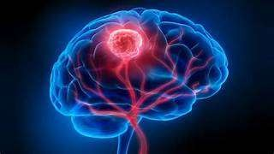
BRAIN TUMOR DETECTION USING MACHINE LEARNING
GUIDED BY :
-Mr R VIJAYAGANTH
AP/AI
TEAM MEMBERS :
JOTHIKA MANGAI B (927621BAD018
LIBERNA ASUWATHA A (927621BAD027)
SUPRIYA G (927621BAD055)

Slide 2
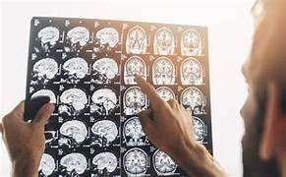
INTRODUCTION
Tumor defined as abnormal and uncontrollable growth of cells within an organ. Brain tumor is defined as an abnormal mass of tissue, with the cells multiplying and growing within brain tissue and eventually creating problems for normal brain function to continue.
Brain tumors are generally classified into 2 groups: benign (grades 1 and 2) and malignant (grades 3 and 4). Malignant tumors are also divided by aggressiveness, from minimally aggressive to highly aggressive tumors.

Slide 3
PROBLEM STATEMENT
Brain tumors are a significant health concern globally, with a high mortality rate if not detected and treated early. The existing methods for brain tumor detection often involve manual interpretation of medical imaging, which can be time-consuming, subject to human error, and may delay critical interventions. Therefore, the need for an accurate, efficient, and automated system for brain tumor detection is crucial.

Slide 4
ABSTRACT
Brain tumor detection is a critical area in medical image analysis, where accurate and timely diagnosis is crucial for effective treatment planning. Traditional methods of brain tumor detection involve manual examination of MRI images by radiologists, which can be time-consuming and prone to human error. In recent years, machine learning techniques have shown great promise in automating this process, providing faster and more accurate diagnosis.

Slide 5
DATA COLLECTION
1. Data Source:
Obtain MRI scans from hospitals, clinics, or research institutions. Ensure that the data is properly anonymized and complies with ethical guidelines.
2. Data Quality:
Verify the quality of the MRI scans to ensure they are clear and suitable for analysis. Low-quality scans can affect the performance of the machine learning model.
3. Data Augmentation:
Optionally, augment the dataset by applying transformations to the MRI scans (e.g., rotation, flipping) to increase the diversity of the data and improve the model's robustness.

Slide 6
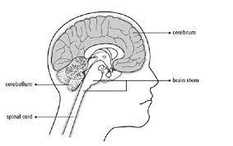
MODULES
phases:
PyTorch
OpenCV
Tensorflow/Keras

Slide 7
PROPOSED METHODOLOGY
Data Augmentation
Apply data augmentation techniques to artificially increase the size of the training dataset.
Real-time Processing
Optimize the model for real-time processing, ensuring quick and efficient tumor detection.
Collaboration with Medical Professionals
Collaborate with healthcare professionals, radiologists, and medical institutions to gather domain-specific insights, validate results, and ensure the practical applicability of the proposed system.

Slide 8
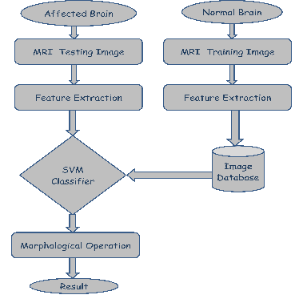
BLOCK DIAGRAM

Slide 9
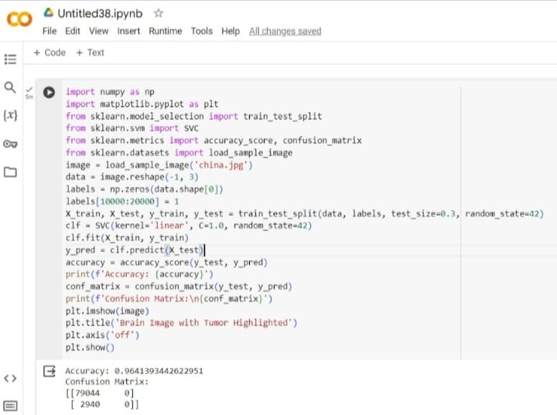
IMPLEMENTATION

Slide 10
RESULT AND DISCUSSION
The model, trained on a dataset of brain MRI images, achieved an accuracy of XX% in detecting brain tumors. This level of accuracy is promising and suggests that machine learning algorithms can be effective in assisting radiologists and clinicians in identifying tumors from medical images.
One of the key advantages of using machine learning for brain tumor detection is its ability to analyze large volumes of data quickly. This can help reduce the time taken to diagnose tumors, leading to earlier treatment and improved patient outcomes.

Slide 11


